Slide 1
Digital Logic Families Q.1 What are the logic families ?
Various digital ICs available in market belong to various types. These types are known as "families".
Based on the components and devices internally used, the digital IC families are named as RTL (Resistor transistor logic), TTL (Transistor Transistor Logic), DTL (Diode Transistor Logic), CMOS etc.

Slide 2
Characteristics of Digital ICS
Define following terms:
Voltage parameters (Threshold levels): Ideally the input voltage levels of 0 V and +5 V (for TTL) are called as logic 0 and 1 levels respectively.
However practically we won't always observe or obtain the voltage levels matching exactly to these values.
Therefore it is necessary to define the worst case input voltages

Slide 3
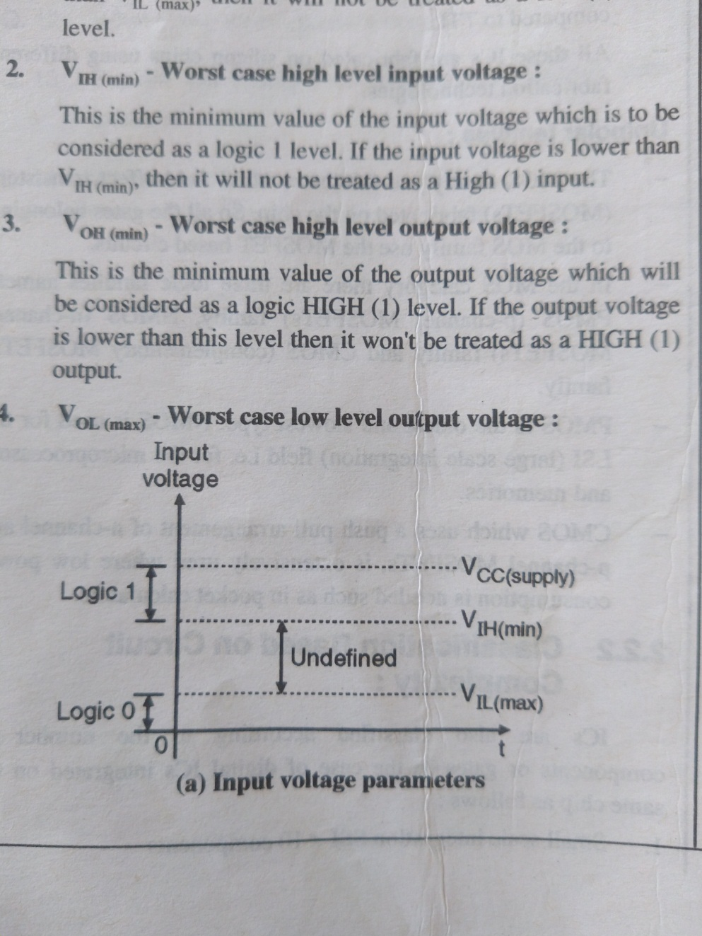
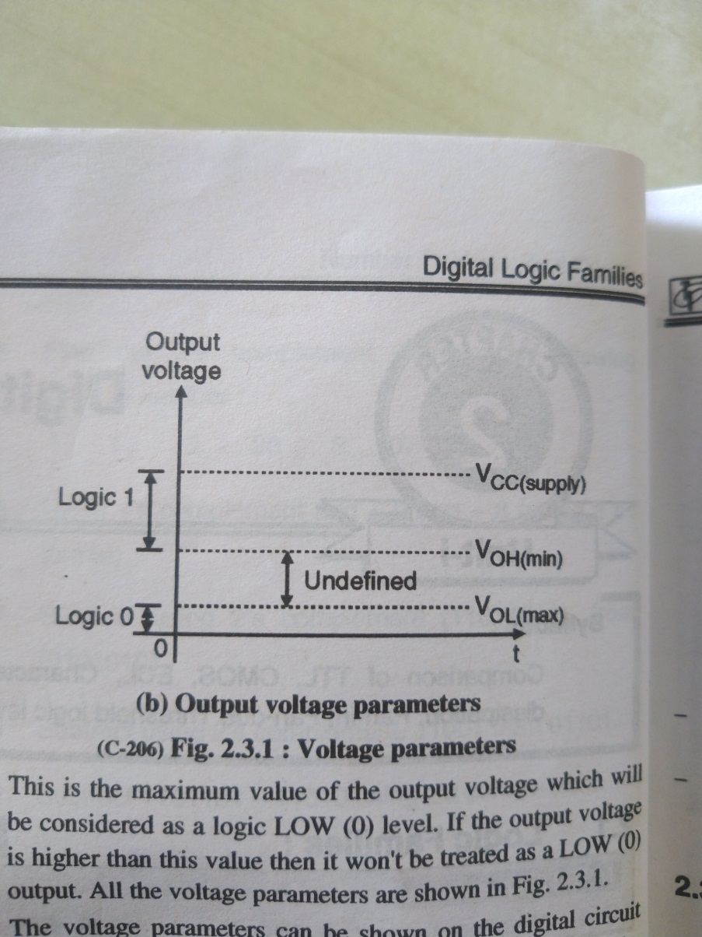
VIL(max)-Worst case low level input voltage:
This is the maximum value of input voltage which is to be considered as a logic 0 level. If the input voltage is higher than V₁, then it will not be treated as a low (0) input level.
VIL (min)Worst case high level input voltage:
This is the minimum value of the input voltage which is to be considered as a logic 1 level. If the input voltage is lower than Vut then it will not be treated as a High (1) input.
Vol (min)-Worst case high level output voltage:
This is the minimum value of the output voltage which will be considered as a logic HIGH (1) level. If the output voltage is lower than this level then it won't be treated as a HIGH (1) output.
VOL Worst case low level output voltage:
This is the maximum value of the output voltage which will be considered as a logic LOW (0) level. If the output voltage is higher than this value then it won't be treated as a LOW (0) output.

Slide 4
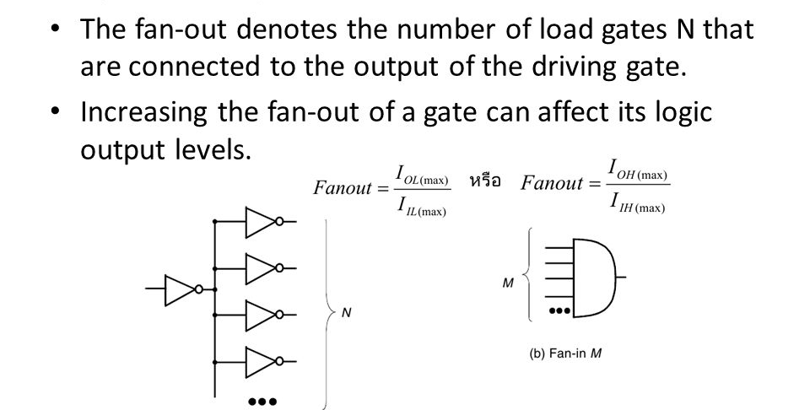
Fan-in Fan-out Q. Define following terms**
Fan-in is defined as the number of inputs a gate has. For example a two input gate will have a fan-in equal to 2.
Fan-out is defined as the maximum number of inputs of the same IC family that a gate can drive without falling outside the specified output voltage limits.
Higher fan out indicates higher the current supplying capacity of a gate. For example, a fan out of 5 indicates that the gate can drive (supply current to) at the most 5 inputs of the same IC family.

Slide 5
"Noise Margin" or "Noise Immunity"
Noise is an unwanted electrical disturbance which may induce some voltage in the connecting wires used between two gates or from a gate output to load.
Noise immunity is defined as the ability of a logic circuit to tolerate the noise without causing the output to change undesirably.
A quantitative measure of noise immunity of a logic family is known as noise margin.

Slide 6
Propagation delay
The output of a logic gate does not change its state instantaneously when the state of its input is changed.
There is a time delay between these two time instants, which is called as the propagation delay.
Thus propagation delay is defined as time delay between the instant of application of an input pulse and the instant of occurrence of the corresponding output pulse.

Slide 7
Define figure of merit.
The figure of merit of a logical family is the product of power dissipation and propagation delay. It is called as the speed power product. The speed is specified in seconds and power is specified in W.
:: Figure of merit = Propagation delay time x Power dissipation.

Slide 8
TTL Family
The long form of TTL is transistor Logic. The digital ICs in the TTL Family use only transistors as their basic building block.
A transistor is a semiconductor device used to amplify or switch electronic signals and electrical power.

Slide 9
Advantages of TTL:
TTL circuits are fast.
Low propagation delay.
Power dissipation is not dependent on frequency.
Compatible to all the other families.
These are not susceptible to the damage due to static charges
Disadvantages of TTL :
1. Large power dissipation.
2. Fan out is lower than that of CMOS.
3. Less component density.
4.Poor noise immunity
5.Can operate only on +5 V power supply.

Slide 10
CMOS Logic:
CMOS stands for complementary MOSFET. It is obtained by using a p-channel MOSFET and n-channel MOSFET simultaneously.
The p and n channel MOSFETs are connected in series, with their drains connected together and output taken from common drain point
Input is applied at the common gate terminal formed by connecting two gates together.

Slide 11
Write advantages of CMOS logic family.
Low power dissipation.
High fan out (typically 50).
High noise margin for higher values of VDD
Capable of working over a wide range of supply voltage.
Switching speeds comparable to those of TTL.
High packaging density (more devices can be accommodated in the same space) since MOS devices need less space.
Disadvantages of CMOS:
1. Propagation delays longer than those of TTL (25 to 100 nS).
2. Slower than TTL.
3. CMOS ICS can get damaged due to static charge.
4. Need protection circuitry.

Slide 12
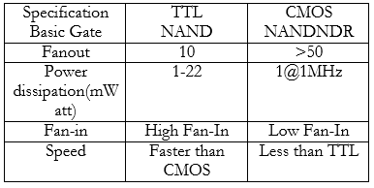
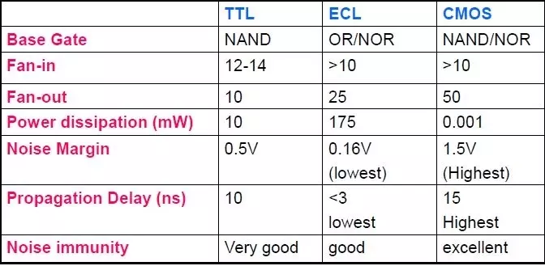

Slide 13
Digital Logic circuits
Digital Logic circuits operate in the binary mode where each input and output is either 0 or 1.
The 0 and 1 do not represent actual numbers but instead represent the state of the voltage variable or logic level.
So in the digital logic field, several other terms are used synonymously with 0 and 1.
LOGIC 1 | LOGIC 0
HIGH | LOW
TRUE | FALSE
ON | OFF
+5V | 0V

Slide 14
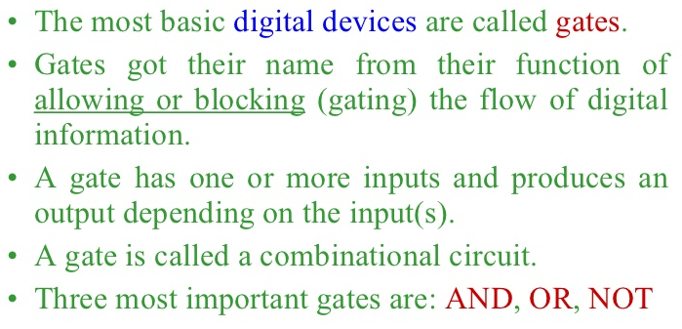
Logic Gates

Slide 15
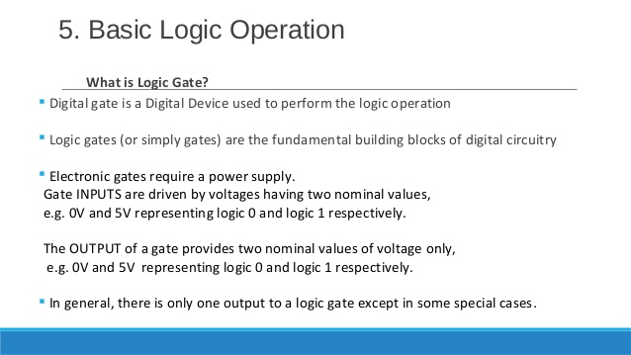

Slide 16
Q. Define any two characteristics of logic gates
Logic gates are the logic circuits which act as the basic building blocks of any digital system. It is an electronic circuit having one or more than one inputs and only one output.
The relationship between the input and the output is based on a "certain logic".
Depending on this logic, the gates are named as NOT gate, AND gate, OR, NAND, NOR etc. We have to use different laws, rules and theorems to analyze the digital circuits.
By connecting the gates, in different ways, we can build circuits that can perform arithmetic and other functions associated with the human brain.
Because they simulate mental processes, gates are often called as logic circuits.
The two important characteristics of logic gates are: Truth table and Boolean expression.

Slide 17
Truth table :
The operation of a logic gate or a logic circuit can be best understood with the help of a table called "Truth Table". The truth table consists of all the possible combinations of the inputs and the corresponding state of output produced by that logic gate or logic circuit.
Boolean expression :
The relation between the inputs and the outputs of a gate can be expressed mathematically by means of the Boolean Expression.

Slide 18
Classification of Logic Gates
Logic gates
Basic Universal Derived
NOT
OR
AND
NAND
NOR
EX-OR
EX-NOR

Slide 19
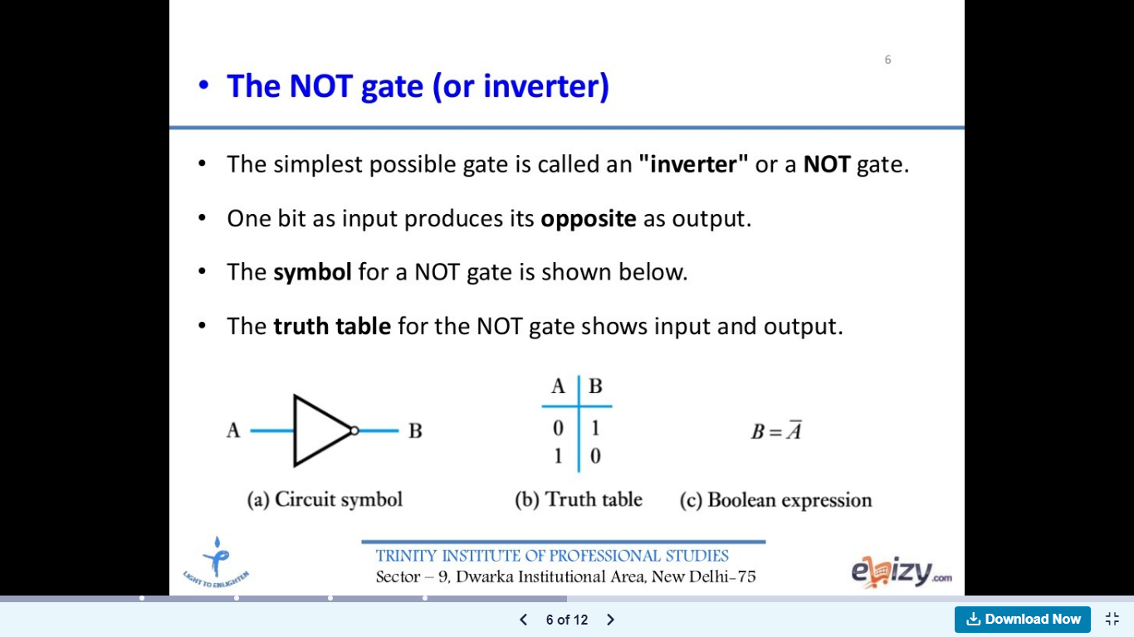
Q. Define Basic gates with their symbols and truth table
The NOT gate or Inverter is a logic gate having one input (A) and one output (Y). Its symbol and truth table are shown in Fig. below
The NOT gate is also known as an "Inverter" because its output is the inverted version or "complement" of its input. This is shown in the truth table of NOT gate.
The bubble (o) in the symbol of a NOT gate indicates the inversion operation
Bubble represents inversion
Input A
Output B

Slide 20
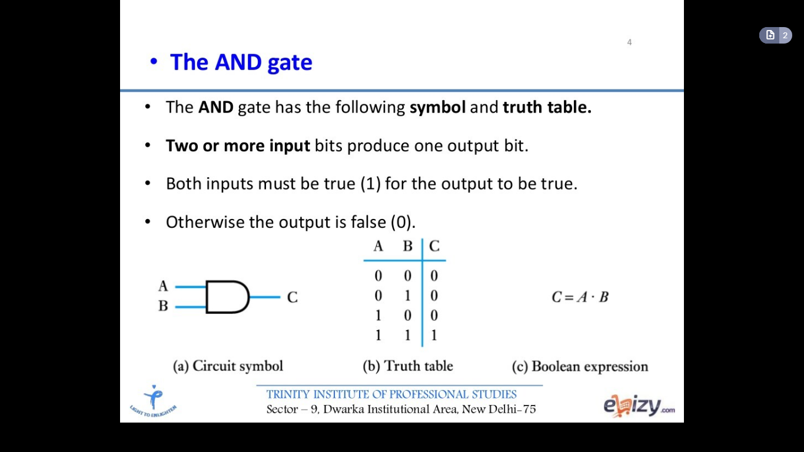
Q. Define AND gate with its symbol and truth table
AND is one of the logic operators. It performs the logical multiplication on its inputs.
The output is high (Y= 1) if and only if all the inputs to the AND gate are high (1). The output is low (0), if any one or more inputs are low (0). AND gate can have two or more inputs and only one output.
The logical symbol of a two input AND gate is as shown below
Boolean expression : The expression relating the inputs (A. B) and output (Y) of a gate is called as the expression. The Boolean expression for an AND gate is,
Y = A.B
where the "dot" between A and B represents multiplication.

Slide 21
Universal Gates Q. What are Universal gates ? Explain **
The NAND and NOR gates are called as “Universal gates” because it is possible to implement any Boolean expression with the help of only NAND or NOR gates.
Therefore a user can build any logical circuit with the help of only NAND or only NOR gates.
This is a great advantage because a user will have to make a stock of only NAND or NOR gates ICs with him.

Slide 22
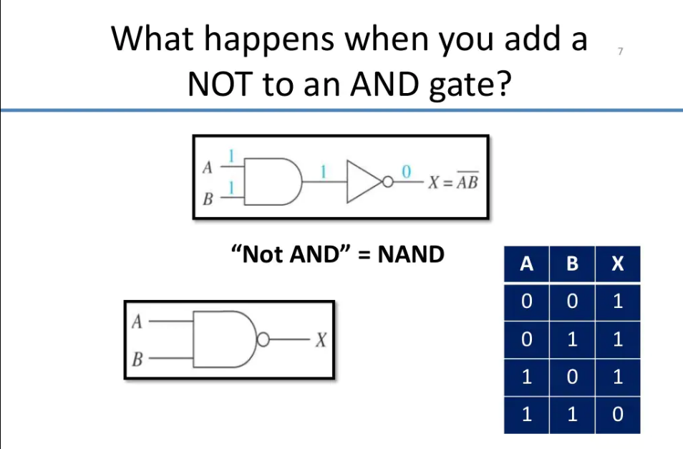

Slide 23
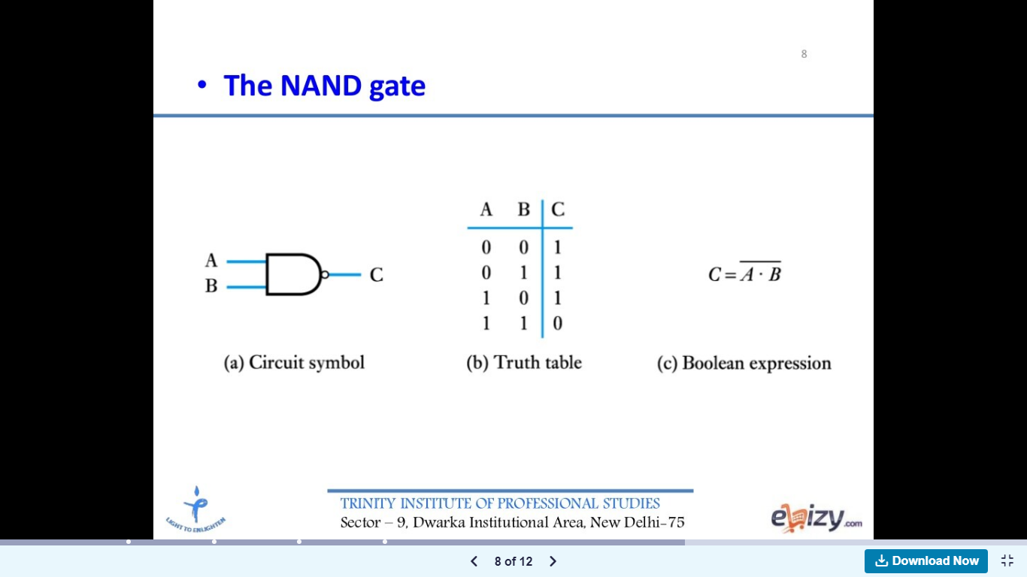
The term NAND can be split as NOT-AND which means that the NAND operation can be implemented with the combination of an AND gate and a NOT gate i.e. inverter.
Thus a NAND gate is equivalent to an AND gate followed by an inverter as shown in Fig. below
The truth table of a two input NAND gate is shown below which shows that the output is low (0) if and only if both the inputs are high (1) simultaneously. For all other input combinations the output voltage will be high (1).
A NAND gate is called as "Universal Gate" because we can construct AND, OR and NOT gates using only NAND gates.

Slide 24
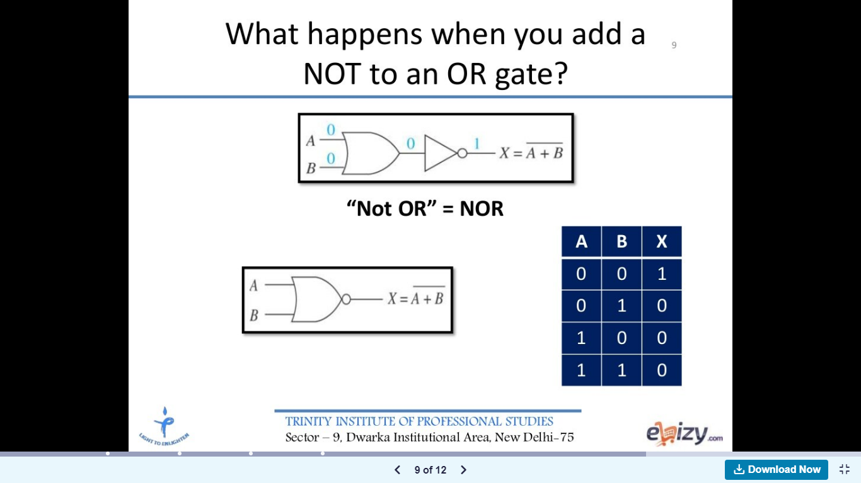

Slide 25
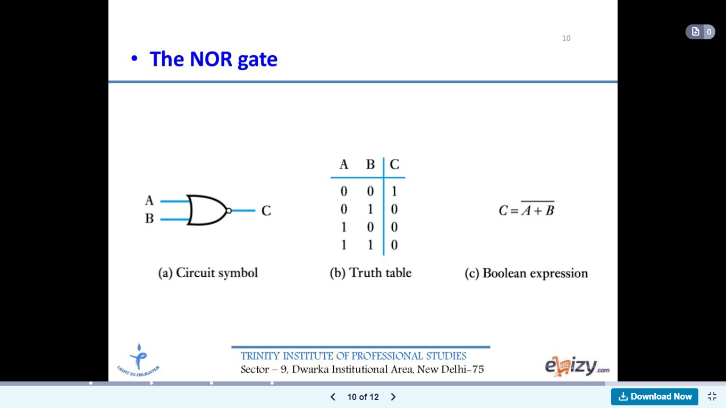
This is another universal gate.
The word NOR can be split as NOT-OR which means that a NOR operation can be implemented with the combination of an OR gate and a NOT gate, i.e. inverter. Thus a NOR gate is equivalent to an OR gate followed by an inverter as shown in Fig.
The symbol of a two input NOR gate is shown in Fig. 3.10.1(a), where a bubble (o) on the output side represents inversion. The truth table of a two input NOR gate is shown in
Fig. shows that "the output of a NOR gate is high (1) if and only if all its inputs are low (0) simultaneously". The output of a two input NOR gate is low (0) if any one or all the inputs are at high (1) level.

Slide 26
EX-OR and EX-NOR Gates :
EX-OR and EX-NOR gates are special type of gates. They can be used for applications such as half adder, full adder and subtractors.
These gates are also called as Derived gates

Slide 27
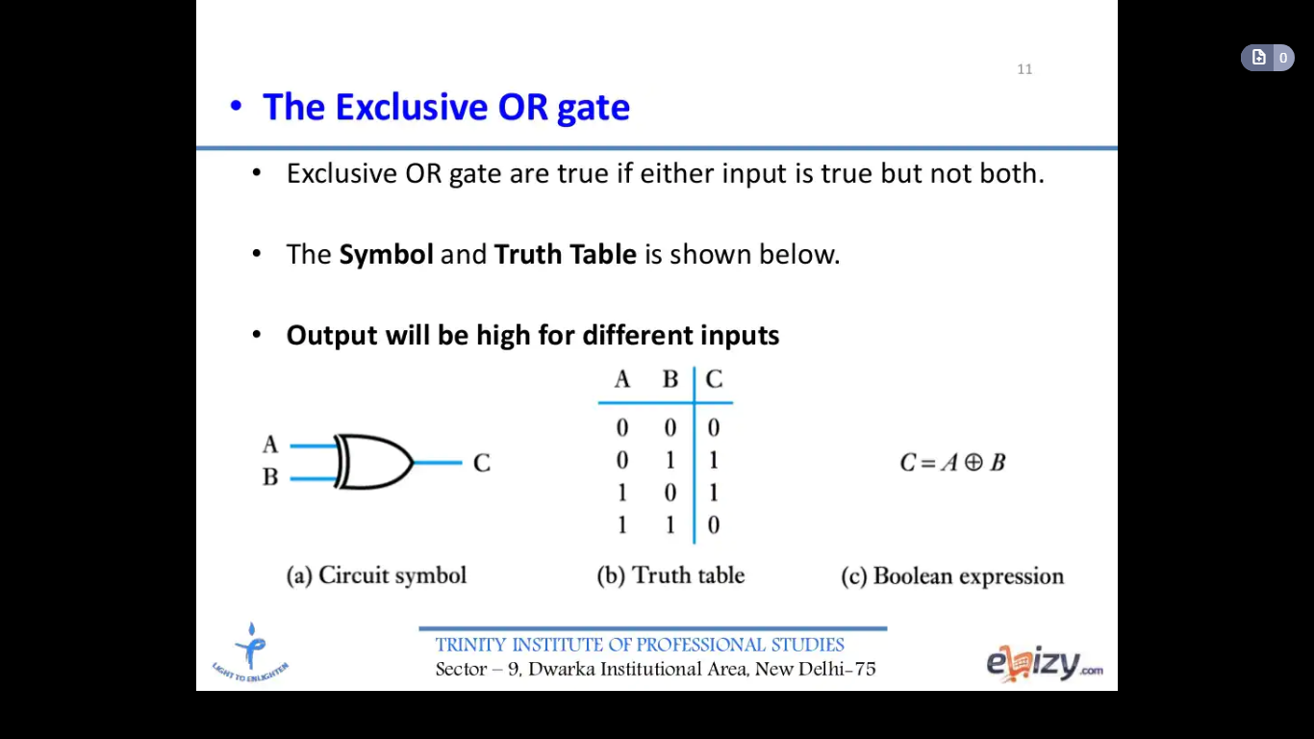
The exclusive-OR gate is abbreviated as EX-OR gate or sometimes as X-OR gate.
An EX-OR gate having two input terminals and one output terminal is shown in Fig.
The truth table of a two input EX-OR gate is shown in Fig, which shows that, when both the inputs are at identical logic levels (A = B), the output is low (0) i.e. Y = 0 for A = B = 0 or A = B = 1, and the output is high (1) when A and B are not equal.
A B+A B

Slide 28
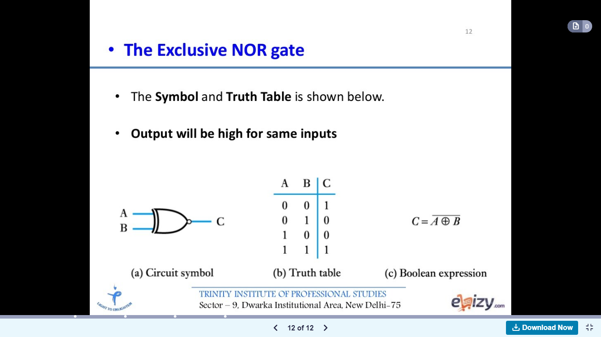
The word EX-NOR is a short form of exclusive-NOR. Exclusive-NOR means NOT-exclusive OR, so EX-NOR gate is equivalent to an EX-OR gate followed by a NOT gate.
The symbol for a two input EX-NOR gate is as shown in Fig. and its truth table is given in Fig. which shows that the output of an EX-NOR gate is high (1) if both the inputs are identical (A = B) and the output is low (0) if the inputs are not identical (A #B).
The Boolean expression for an EX-NOR gate is given by,
A B+A B

Slide 29
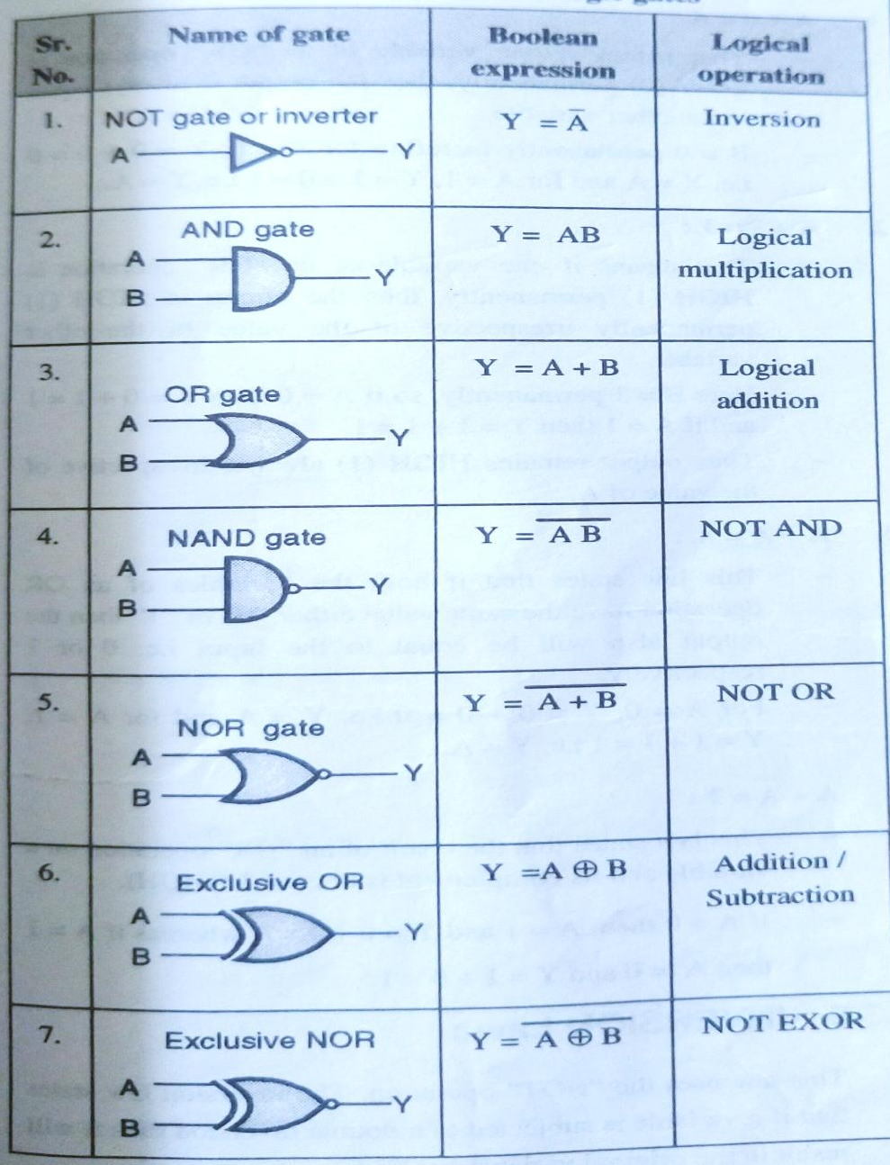
Q. Draw symbols and logic expressions for all gates

Slide 30
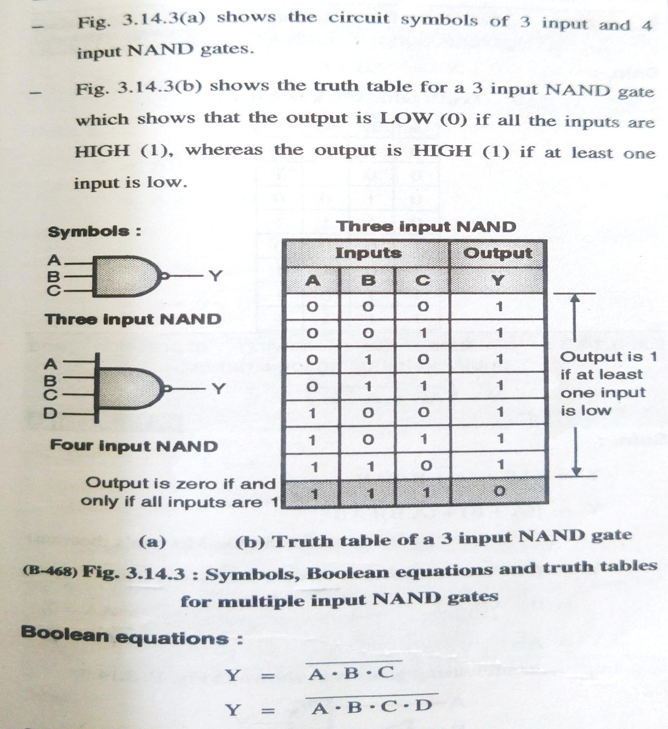
Gate using more than 2 inputs

Slide 31
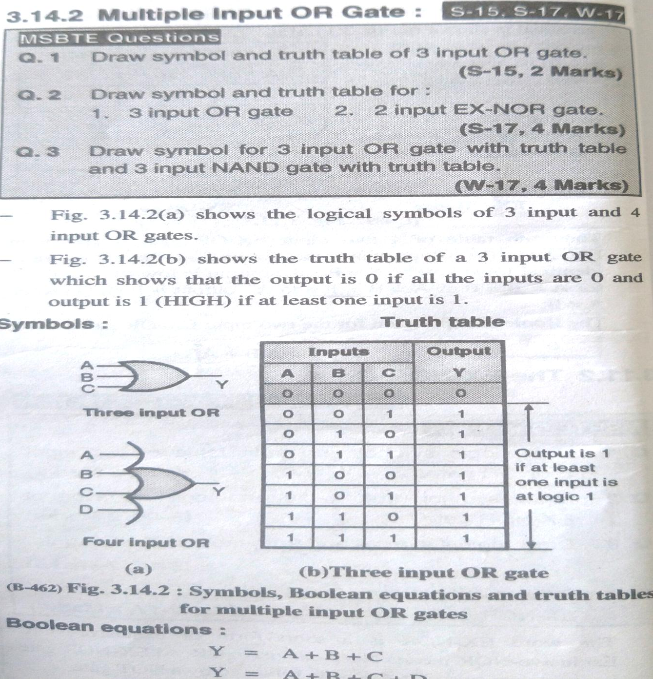

Slide 32
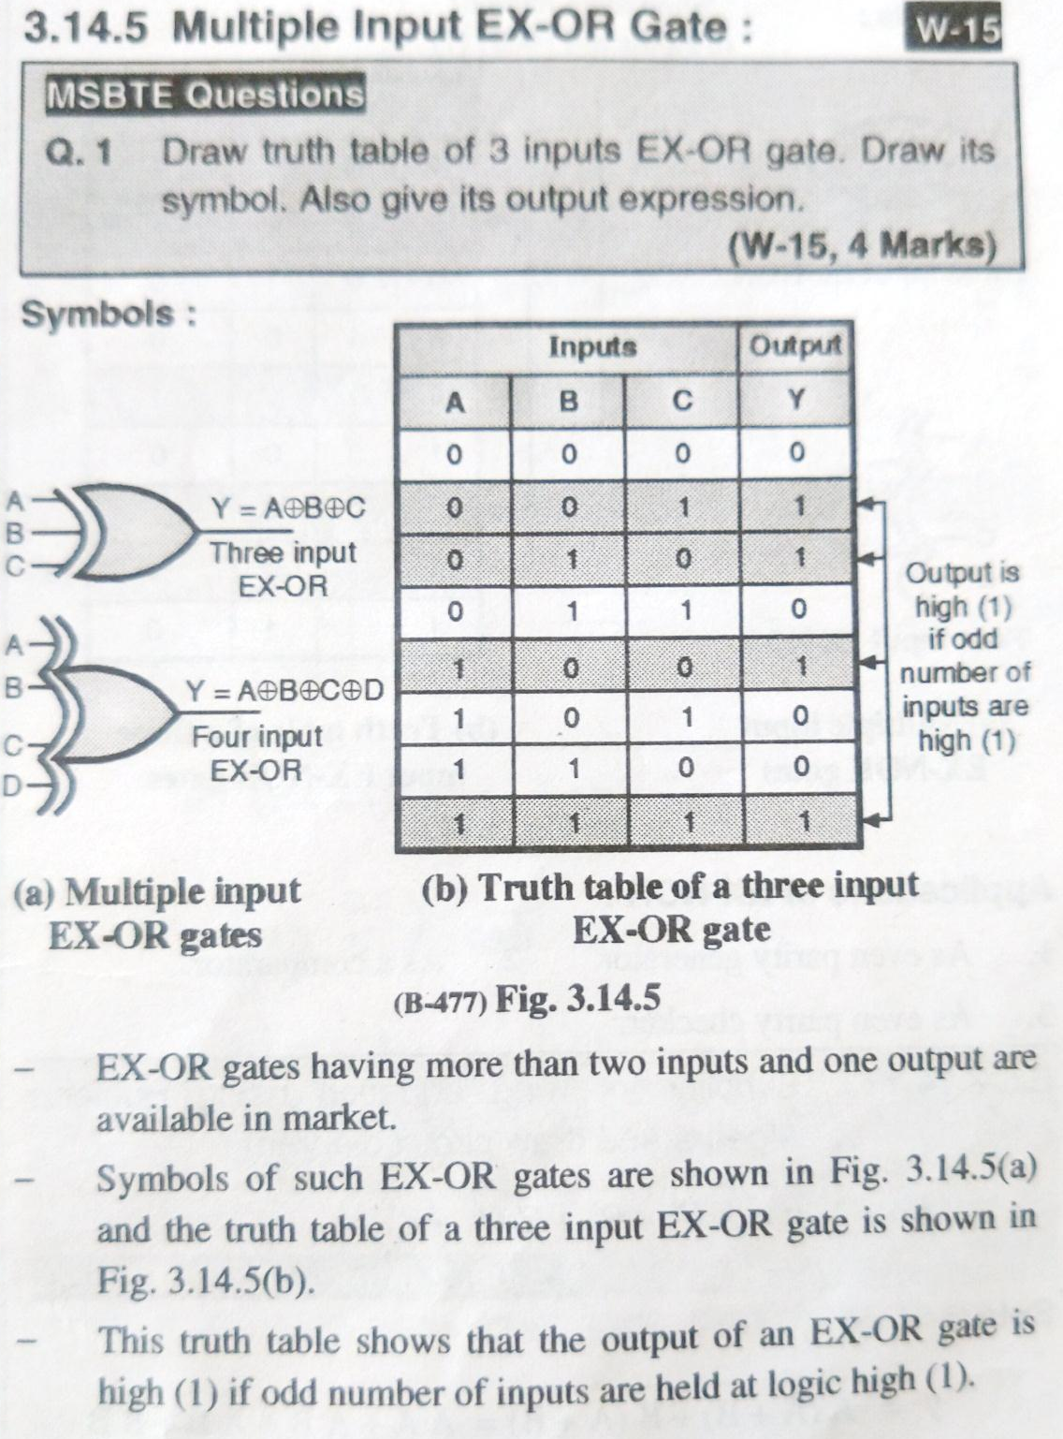

Slide 33
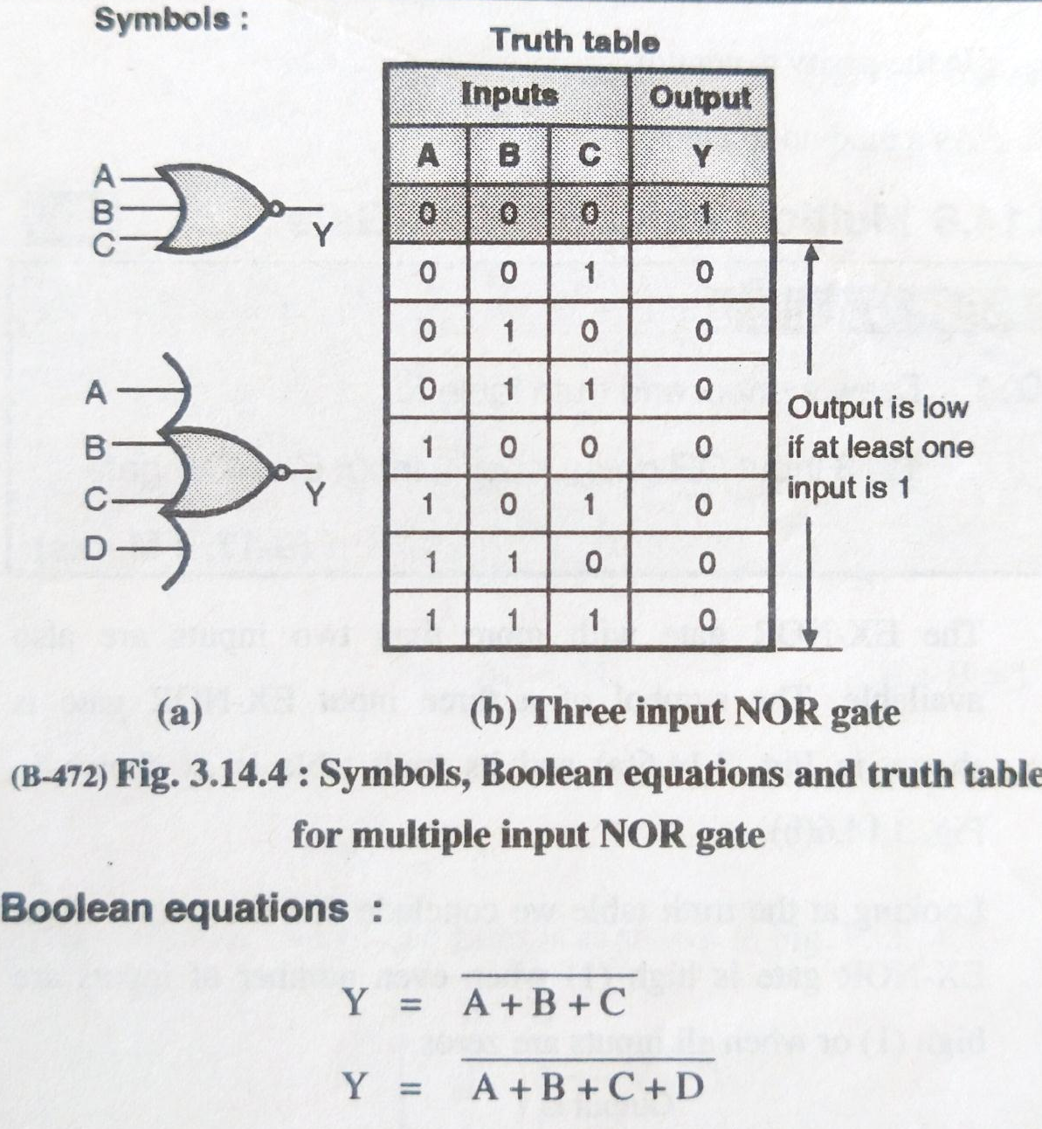

Slide 34
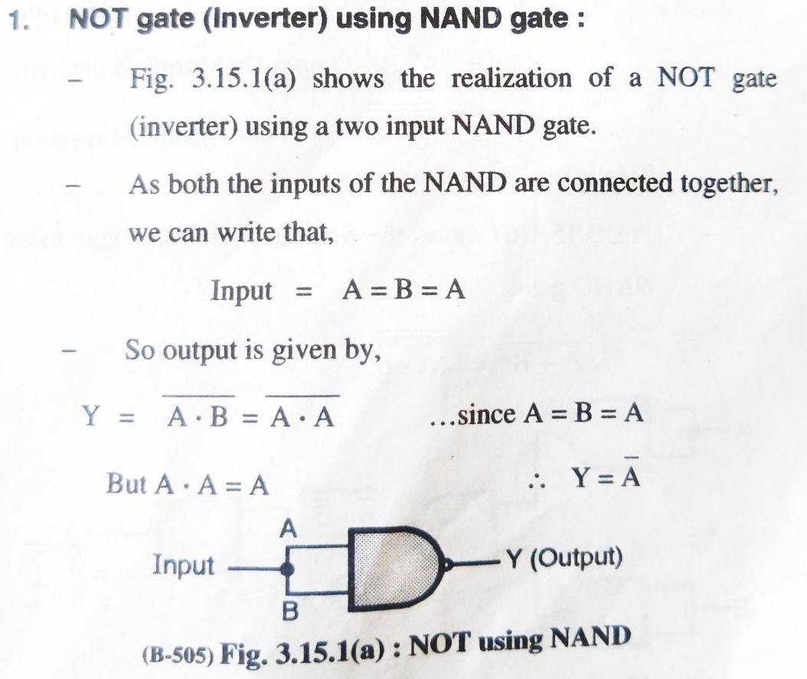
NAND Gate as Universal gate
NOT gate using NAND gate

Slide 35
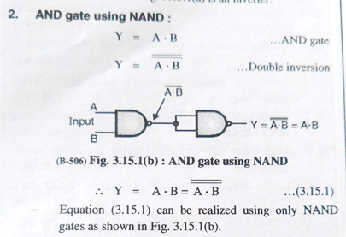
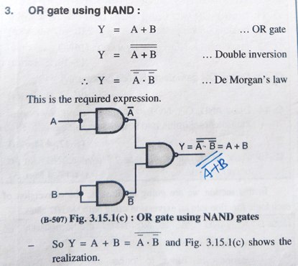

Slide 36
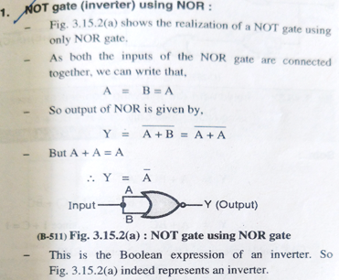
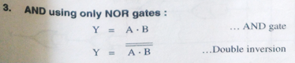
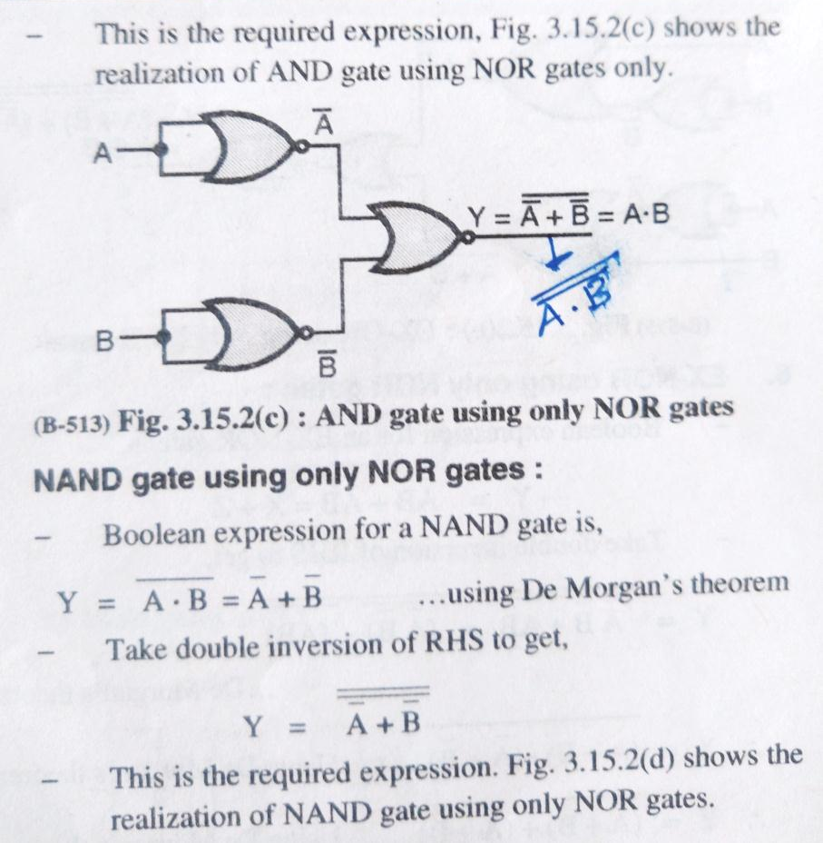
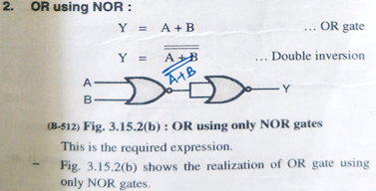
NOR Gate as Universal gate

Slide 37
Boolean Laws Q. State any four Boolean laws used to reduce Boolean Expression ****
Commutative law.
Associative law.
Distributive law.
OR law.
AND law
INVERSION law

Slide 38
Boolean Algebra is used to analyze and simplify the digital (logic) circuits. Since it uses only the binary numbers i.e. 0 and 1 it is also called as "Binary Algebra", or "Logical Algebra".
It was invented by George Boole in the year 1854.
Rules in boolean algebra :
There are some rules to be followed while using a Boolean algebra, these are:
1. Variables used can have only two values. Binary 1 for HIGH and Binary 0 for LOW.
2. Complement of a variable is represented by a overbar (-). Thus complement of variable B is represented as B. Thus if
B=0 then B = 1 and if B = 1 then B = 0.
3. ORing of the variables is represented by a plus (+) sign between them. For example ORing of A, B, C is represented as A + B + C.
4. Logical ANDing of the two or more variables is represented by writing a dot between them such as A B C.D.E. Sometimes the dot may be omitted like ABCDE.

Slide 39
Commutative Law:
Any binary operation which satisfies the following expression is known as commutative operation :
1. A.B=B.A
2. A+B=B+A
Thus the commutative law states that we can change the sequence of the variables (inputs) without having any effect on the output of a logic circuit.

Slide 40
Associative Law:
This law states that the order in which the logic operations are performed is not at all important ultimate outcome is the same.
i.e. (A.B) C = A (B.C) and
(A+B) + C = A + (B+C)

Slide 41
Distributive Law:
The distributive law states that,
A (B+C) = AB+ AC

Slide 42
AND Laws :
These laws are related to the AND operation therefore they are called as "AND" laws. The AND laws are as follows:
1. A.0=0:
That means if one input of an AND operation is permanently kept at the LOW (0) level, then the output is zero irrespective of the other variable.
2. A.1 =A:
That means if one input of an AND operation is HIGH (1) permanently then the output is always equal to the other variable.
3. A.A=A
That means if both the inputs in an AND operation have the same value either “0" or "1" then the output will also have the same value as that of the input.
4.A.A=0
This law states that the result of an "AND" operation on a variable (A) and its complement (A) is always LOW (0)

Slide 43
OR laws
These laws use the OR operation. Therefore they are called as OR laws. The OR laws are as follows:
1. A +0=A:
That means if one variable of an "OR" operation is LOW (0) permanently, then the output is always equal to the other variable.
2. A+1=1:
That means if one variable of an "OR" operation is HIGH (1) permanently, then the output is HIGH (1) permanently irrespective of the value of the other variable.
3. A + A = A:
This law states that if both the variables of an OR operation have the same value either "0" or "1" then the output also will be equal to the input i.e. 0 or 1 respectively.
4. A+A=1:
This law states that the result of an "OR" operation on a variable and its complement is always 1 (HIGH).

Slide 44
INVERSION Law
This law uses the “ NOT” operation. The inversion law states that if a variable is subjected to a double inversion then it will result in the original variable itself.
A=A

Slide 45
Other Important Rules
1. A+AB=A
LHS=A+AB
=A(1+B)
But 1+B=1
∴LHS=A.1=A Since A.1=A
∴ A+AB=A
Hence proved.
2. A + AB=A+B
LHS = A + AB
Substitute A = A + AB
LHS = A + AB + AB = A + B (A + A)
But A + A = 1
:: LHS = A + B (1) = A + B
.. A + AB = A + B
Hence proved.

Slide 46
3. (A + B) (A + C) = A + BC :
LHS = (A + B) (A + C)
= A .A+A .C+B.A+B.C
But A .A = A and B.A =A.B
:. LHS = A + AC + AB + BC
But A + AB = A
.. LHS = A + AC + BC = A (1 + C) + BC
But (1+ C) = 1
:. LHS = A + BC
.. (A + B) (A + C) = A + BC
...Proved.

Slide 47
Duality theorem. Q. State and explain Duality Theorem***
According to the duality theorem the following conversions are possible in a given Boolean expression :
1. Change each AND operation to an OR operation.
2. Change each OR operation to an AND operation.
3. Complement any 1 or 0 appearing in the expression.
2. Duality theorem is sometimes useful in creating new expressions from the given Boolean expressions.
3. For example if the given expression is A + 1 = 1 then replace the OR (+) operation by AND ( ) operation and take complement of 1 to write the dual of the given relation as, A.0 = 0
4. The dual of A.(B+C) = AB + AC is given by,
A+ (B.C) = (A + B). (A + C)

Slide 48
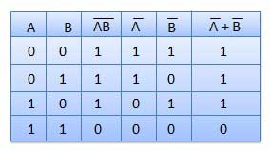
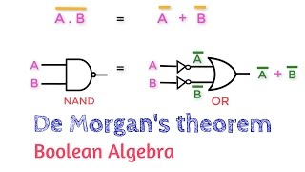
De-Morgan’s Theorem Q. State and Prove De-Morgans Theorem*******
Theorem 1:
A.B=A+B
This theorem states that the complement of the product is equal to the addition of the complement of each term.
This can be shown as follows. The left hand side of this theorem represents a NAND gate with inputs A and B whereas The Right Hand Side represents OR gate with inverted inputs.
This theorem can be verified by writing a truth table as follows
Illustration of De-Morgans First Theorem
Truth table

Slide 49
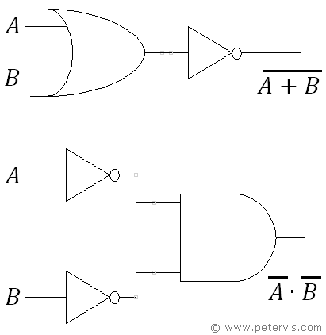
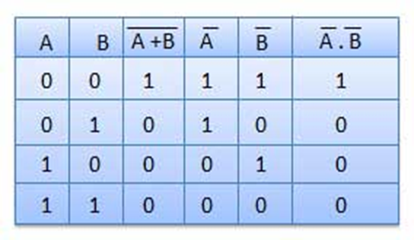
Theorem 2:
A+B = A .B
This theorem states that the complement of the addition is equal to the product of the complement of each term.
This can be shown as follows. The left hand side of this theorem represents a NOR gate with inputs A and B whereas The Right Hand Side represents AND gate with inverted inputs.
This theorem can be verified by writing a truth table as follows
Illustration of De-Morgans First Theorem
Truth table

